Slide 1
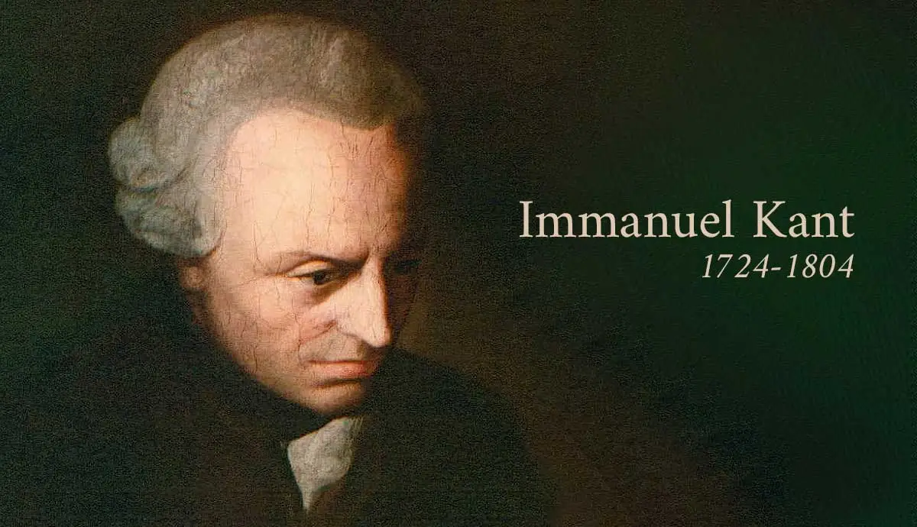
Immanuel Kant

Slide 2
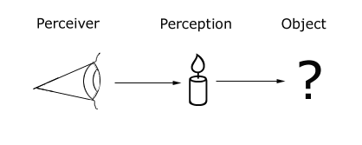
Questions to consider
What is the relationship between what is perceived and what exists?
How useful do you think the distinction between these two objects are?
Noumena: The objects of the world, objects of inquiry, object of analysis for the working of the world
Phenomena: the observable manifestation of noumena

Slide 3

Immanuel Kant (1724-1804)
Most important work Critique of Pure Reason (1781)
Fundamental concern: possibility of real knowledge, of object reality
Eighteenth century philosophy must be reformed, Kant tries to do this

Slide 4
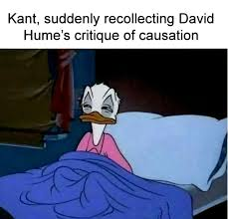
Navigating Rationalism and Empiricism
Hume’s empiricism results in skepticism of external world and the future
  But it was Hume who interrupted Kant’s ‘dogmatic slumber’
  Dogmatic speculation on metaphysics can be disconnected from reality → lead to stand offs or antinomies (contradictions in reason→ like those that arise from applying empirical truths to rationalism) → does the universe have a beginning? Is there a God?
  This discredits reason and fosters skepticism
Claims empiricists are “wrong to treat concepts as pale copies of perceptions”
Kants to distinguish between the idea that all cognition starts with experience (true) with the empiricist idea that it all emerges from experience (false)
  False empiricist notion ignores what arises is supplies from itself by understanding
  Also, we want to avoid a type of rationalism that ignores the application “to possible objects of experience”

Slide 5
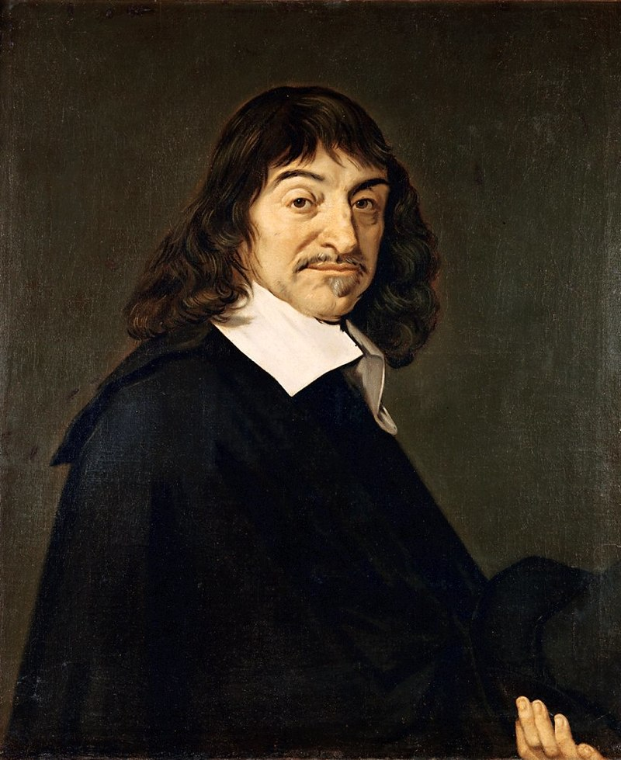
Responding to Descartes’s Dream Argument
In Descartes’s Meditations (1641), Descartes challenges empiricism and the natural sciences
Says that sane people can be sure of their senses → but then says how does he know that he’s sane and sensing real objects?
Feels certain that he is awake and sensing real objects → but remembers dreams that felt real
Dreams can be drawn from real experiences in the same way that a painter (painting fiction) uses shapes, colors, and subjects from real life (e.g. a mermaid)
  Therefore, though he can doubt composite things, he must accept and cannot doubt simple and universal parts
  We can doubt composite sciences like medicine, astronomy and physics, but cannot doubt simple sciences like arithmetic and geometry
This is a rejection of natural sciences as a posteriori knowledge

Slide 6
A priori and a posteriori knowledge
Moving beyond the idea that all knowledge has to come from experience
Makes distinction between a priori and a posteriori knowledge
  A priori knowledge: knowledge that has a ground outside of experience (all necessary and universal truths, like mathematics)
“The question, then, whether there is such a thing as cognition that is independent of experience and even of all impressions of the senses, is one that cannot be disposed of as soon as it comes to light, but that at least still needs closer investigation. Such cognitions are called a priori cognitions; they are distinguished from empirical cognitions, whose sources are a posteriori, namely, in experience” (II, B2).

Slide 7
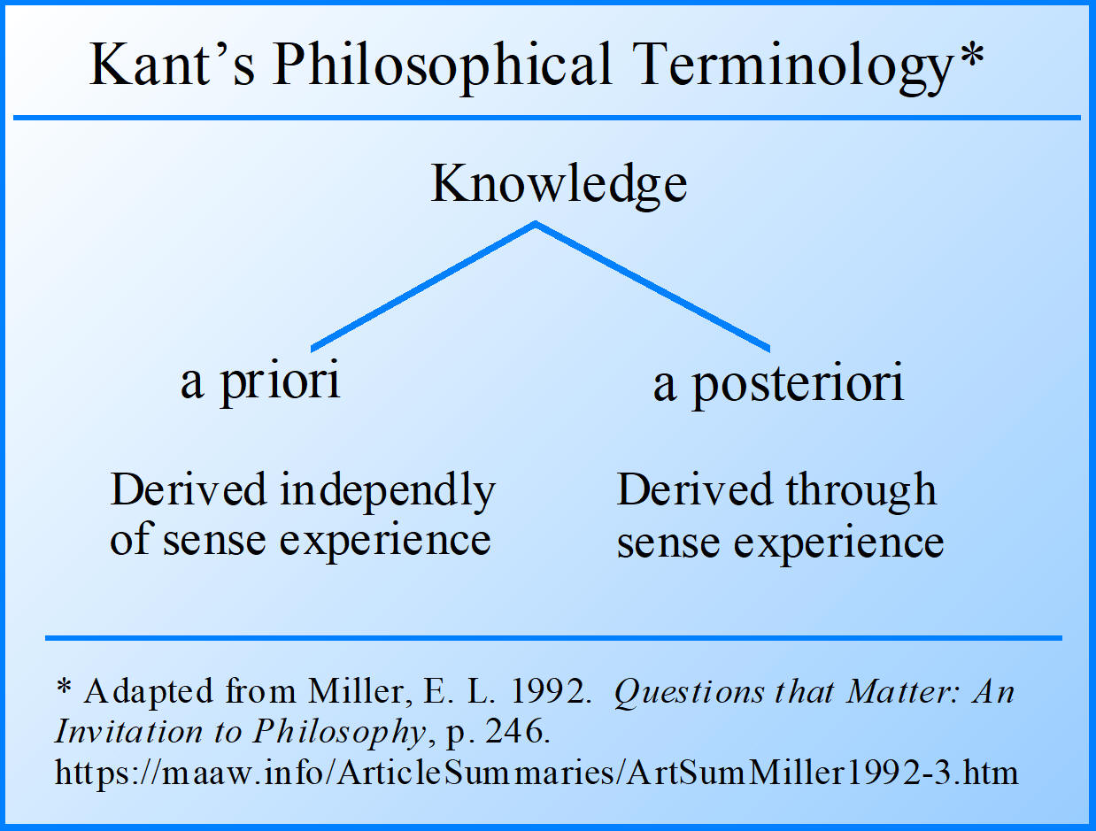
A Posteriori knowledge
A posteriori knowledge: knowledge whose “ground” is experience → experience can only confirm particular truths (truths in particular instances)
    Analytic a priori: All bachelors are unmarried (requires no synthesis of ideas)
    Synthetic a priori: requires synthesis of ideas or other a priori concepts

Slide 8
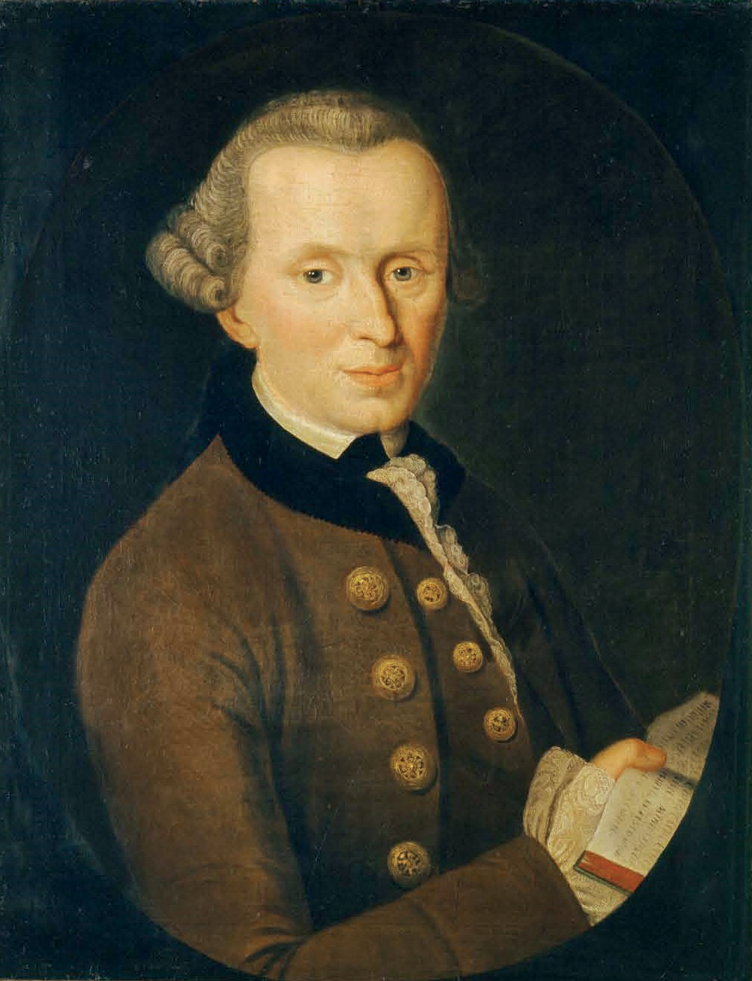
On the synthetic a priori
Previous philosophers did not deny existence of a priori truth
Treated all a priori truths in terms of Kant’s ‘analytic’ truths → not synthetic
Analytic truths understood using only concepts involved
  Kant claims that some a priori truths are analytic (e.g. ‘All bachelors are unmarried’)
  But many are not, e.g. ‘7+5=12’, ‘The quantity of matter in the universe is constant’ and ‘Every event has a cause’ ← these are synthetic a priori truths

Slide 9
Kant against empiricism
“What matters here is that we find a characteristic by which we can safely distinguish a pure cognition from empirical ones. Now, experience does indeed teach us something is thus or thus, but not that it cannot be otherwise” (II. B3).
Pure cognition relates to rationalism and a priori judgements
Experience can only teach us that someone exists, not that it cannot or does not exist

Slide 10
Empiricism cannot grant universal knowledge
“…experience never provides its judgements with true or strict universality, but only (through induction) with assumed and comparative universality; hence [there] we should, properly speaking, say [merely] that as far as we have observed until now, no exception is to be found to this or that rule. If, therefore, a judgement is thought with strict universality, i.e. thought in such a way that no exception whatever is allowed as possible, then the judgment is not derived from experience, but is valid absolutely a priori” (II. B3-B4).

Slide 11
Synthetic a priori can give us knowledge of metaphysics
“Metaphysics is to contain synthetic a priori cognitions. This holds even if metaphysics is viewed as a science that thus far has merely been attempted, but that because of the nature of human reason is nonetheless indispensable. Metaphysics is not at all concerned merely to dissect concepts of things that we frame a priori, and thereby to elucidate them analytically. Rather, in metaphysics we want to expand our a priori cognition. In order to do this, we must use principles which go beyond the given concept and which add to it something that was not contained in it; and, by means of such synthetic a priori judgements, we much presumably go so far beyond such concepts that even experience can no longer follow us; as in the proposition: The world must have a first beginning – and others like that. And hence metaphysics consists, at least in terms of its purpose, of nothing but synthetic a priori propositions” (V, B18).

