Slide 1
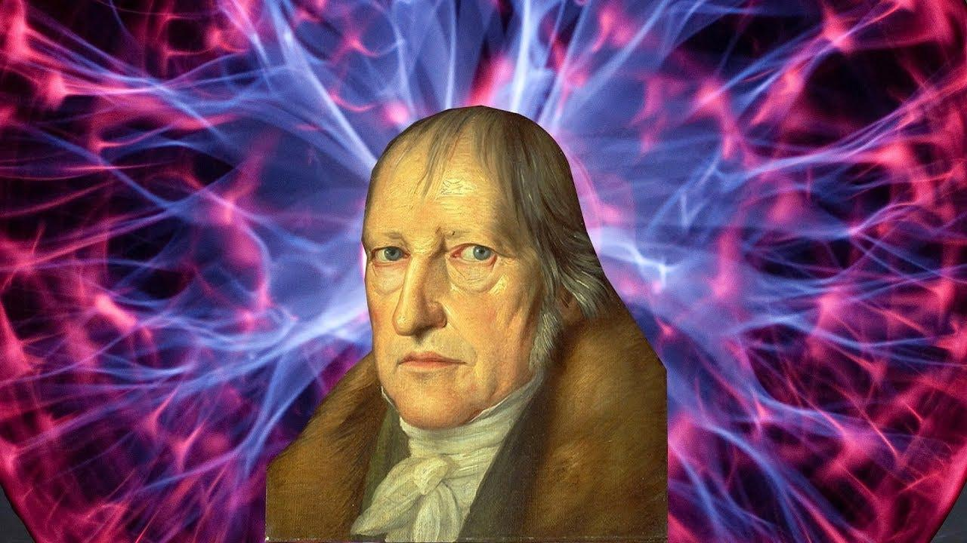
HEGEL
AND THE MASTER-SLAVE DIALECTIC

Slide 2
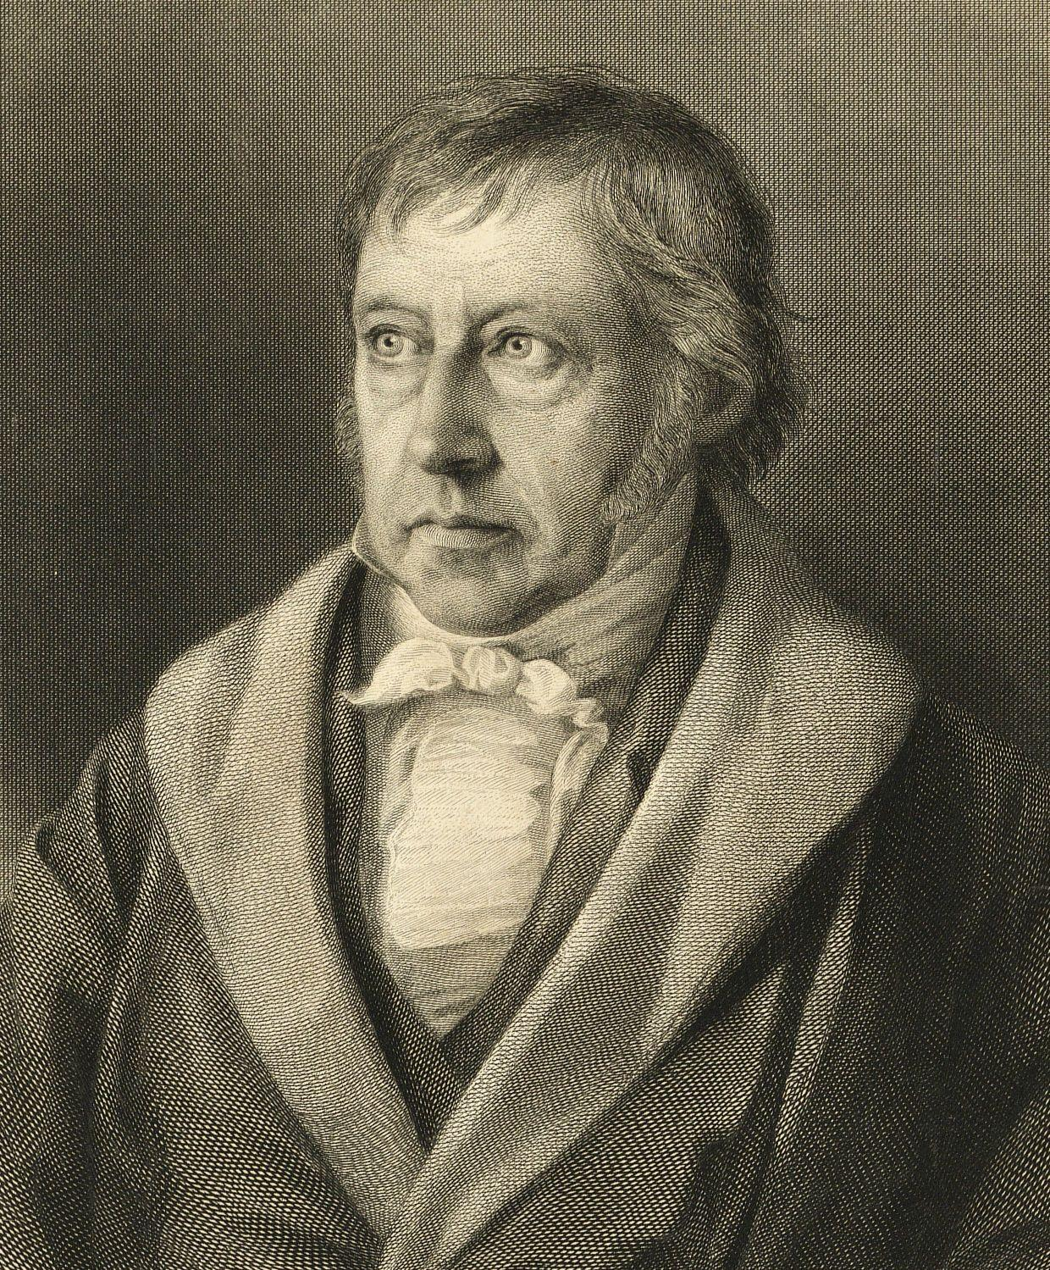
Georg Wilhelm Friedrich Hegel (1770-1831)
Influential German philosopher → biggest figure in 19th-century philosophy
Important in German idealism, epistemology, political philosophy, the philosophy of history, and other fields
Born in Stuttgart during transitional period→ at the end of the Enlightenment and beginning of the Romantic period
French Revolution and Napoleonic Wars
Famous for The Phenomenology of Spirit
Key ideas: telos of history, dialectics, Master-Slave dialectic

Slide 3
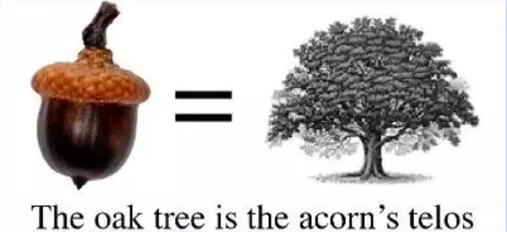
Telos or Teleology
Telos (τέλος) → literally “end” or “goal” or “purpose”
Used in philosophy by Aristotle to talk about the final cause of an organism or entity
Teleology is the study of the purpose of being or objects → thinking about their intentions or aims
Aristotle used telos to think about biological life
Hegel: telos to think about history → the world has a spirit
“That world history is governed by an ultimate design, that it is a rational process – whose rationality is not that of a particular subject, but a divine and absolute reason – this is a proposition whose truth we must assume; its proof lies in the study of world history itself, which is the image and enactment of reason.”
World history is “the rational and necessary evolution of the world spirit.”

Slide 4
The Phenomenology of Spirit (1807)
The first work that is systematic philosophy (Hegelian approach)
Poorly understood by his contemporaries → negative reviews
Dense and confusing work
H. S. Harris's two-volume Hegel's Ladder (commentary on PoS) is twice the length of the original text itself
Fourth chapter: first instance of Hegel’s master-slave dialectic → influential to general culture
Considers mutual recognition or acknowledgement of the universality (personhood, humanity) in two opposed subjectivities
Recognition only successful if reciprocal or mutual
If you cannot recognize someone as properly human, then that recognition is not genuine
Perhaps a critique of individualism → would rather take holistic approach to humanity and consciousness
About the recognition of others and the way we shape our own self-conscious through the view of others

Slide 5
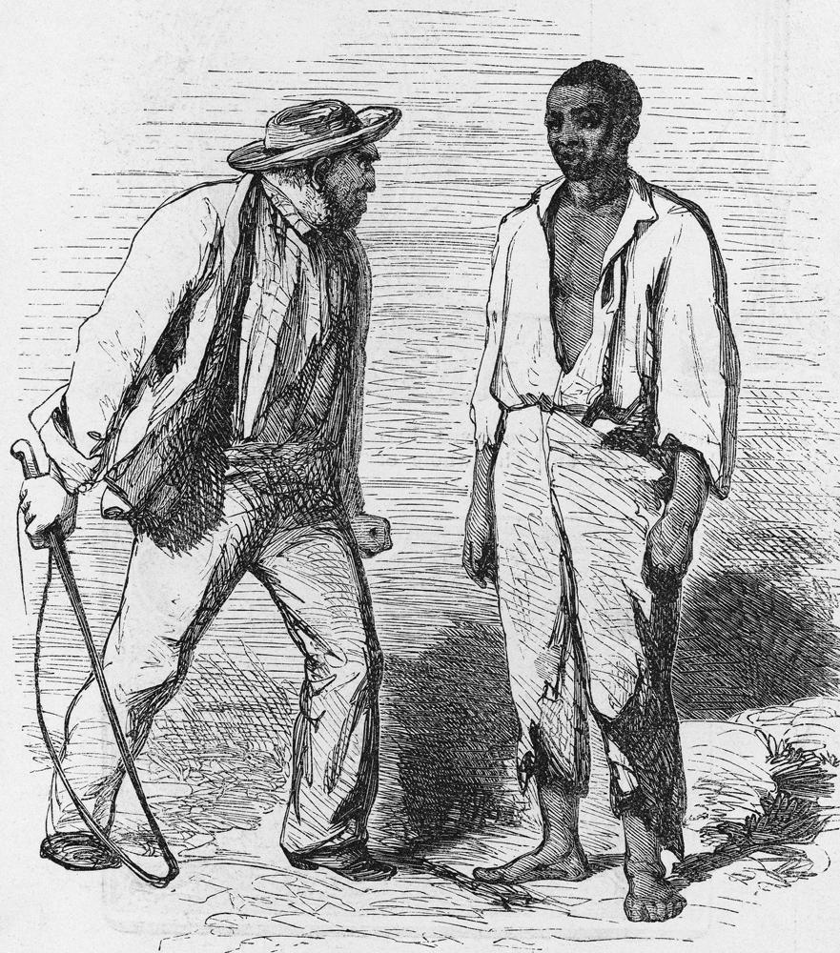
Master-Slave Dialectic
Lord-Bondsman dialectic or “master-slave dialectic”
Self-consciousness develops as an encounter between two distinct subjectivities (compare this with Enlightenment ideas of consciousness as individual)
Central is the movement of recognizing → two self-consciousnesses constituted through being recognized by the other
Common form is power or mastery over another: “struggle to the death”
One wants to master the other, such power/lordship makes recognition of humanity sought impossible → the person who is the slave/bondsman is not free to offer recognition of humanity

Slide 6
Unequal recognition central to Master-Slave Dialectic
“In this experience, self-consciousness learns that life is as essential to it as pure self-consciousness. In immediate self-consciousness the simple ‘I’ is absolute mediation, and has as its essential moment lasting independence. The dissolution of that simple unity is the result of the first experience; through this there is posited a pure self-consciousness, and a consciousness which is not purely for itself but for another, i.e. is a merely immediate consciousness, or consciousness in the form of thinghood. Both moments are essential. Since to begin with they are unequal and opposed, and their reflection into a unity has not been achieved, they exist as two poised shapes of consciousness; one is the independent consciousness whose essential nature is to be for itself, the other is the dependent consciousness whose essential nature is simply to live or be for another. The former is lord, the other is bondsman” (§189).

Slide 7
The Dialectic
“We have what servitude is only in relation to lordship. But it is a self-consciousness, and we have now to consider what as such it is in and for itself. To begin with, servitude has the lord for its essential reality; hence the truth for it is the independent consciousness that is for itself” (§194).

Slide 8
The Slave becomes Free
“In the lord, the being-for-self is an ‘other’ for the bondsman, or is only for him [i.e. is not his own]; in fear, the being-for-self is present in the bondsman himself; in fashioning the thing, he becomes aware that being-for-self belong to him, that he himself exists essentially and actually in his own right. The shape does not become something other than himself through being made external to him; for it is precisely this shape that is his pure being-for-self, which in this externality is seen by him to be the truth. Through this rediscovery of himself by himself, the bondsman realized that it is precisely in his work wherein he seemed to have only an alienated existence that he acquires a mind of his own” (§196).

Slide 9
From Hegel, Philosophy of Right (1821):
“To adhere to man's absolute freedom – one aspect of the matter – is eo ipso to condemn slavery. Yet if a man is a slave, his own will is responsible for his slavery, just as it is its will, which is responsible if a people is subjugated. Hence the wrong of slavery lies at the door, not simply of enslavers or conquerors, but of the slaves and the conquered themselves. Slavery occurs in man’s transition from the state of nature to genuinely ethical conditions; it occurs in a world where a wrong is still right. At that stage wrong has validity and so is necessarily in place.”

Slide 10
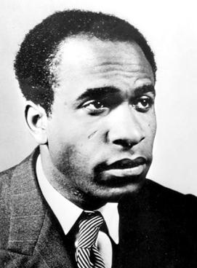
Frantz Fanon, Black Skin, White Masks (1967)
“We hope to have shown that the master here is basically different from the one described by Hegel. For Hegel there is reciprocity; here the master scorns the consciousness of the slave. What he wants from the slave is not recognition, but work. Likewise, the slave here can in no way be equated with the slave who loses himself in the object and finds the source of his liberation in his work. The black slave wants to be like his master. Therefore he is less independent than the Hegelian slave. For Hegel, the slave turns away from the master and turns toward the object. Here the slave turns toward the master and abandons the object.”

Slide 11
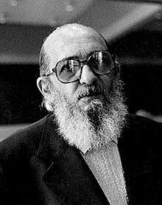
Paulo Freire, Pedagogy of the Oppressed (1970)
“In the banking concept of education, knowledge is a gift bestowed by those who consider themselves knowledgeable upon those whom they consider to know nothing. Projecting an absolute ignorance onto others, a characteristic of the ideology)of oppression, negates education and knowledge as processes of inquiry. The teacher presents himself to his students as their necessary opposite; by considering their ignorance absolute, he- justifies his own existence. The students, alienated like the slave in the Hegelian dialectic, accept their ignorance as justifying the teacher's existence—but, unlike the slave, they never discover that they educate the teacher.”

