Slide 1
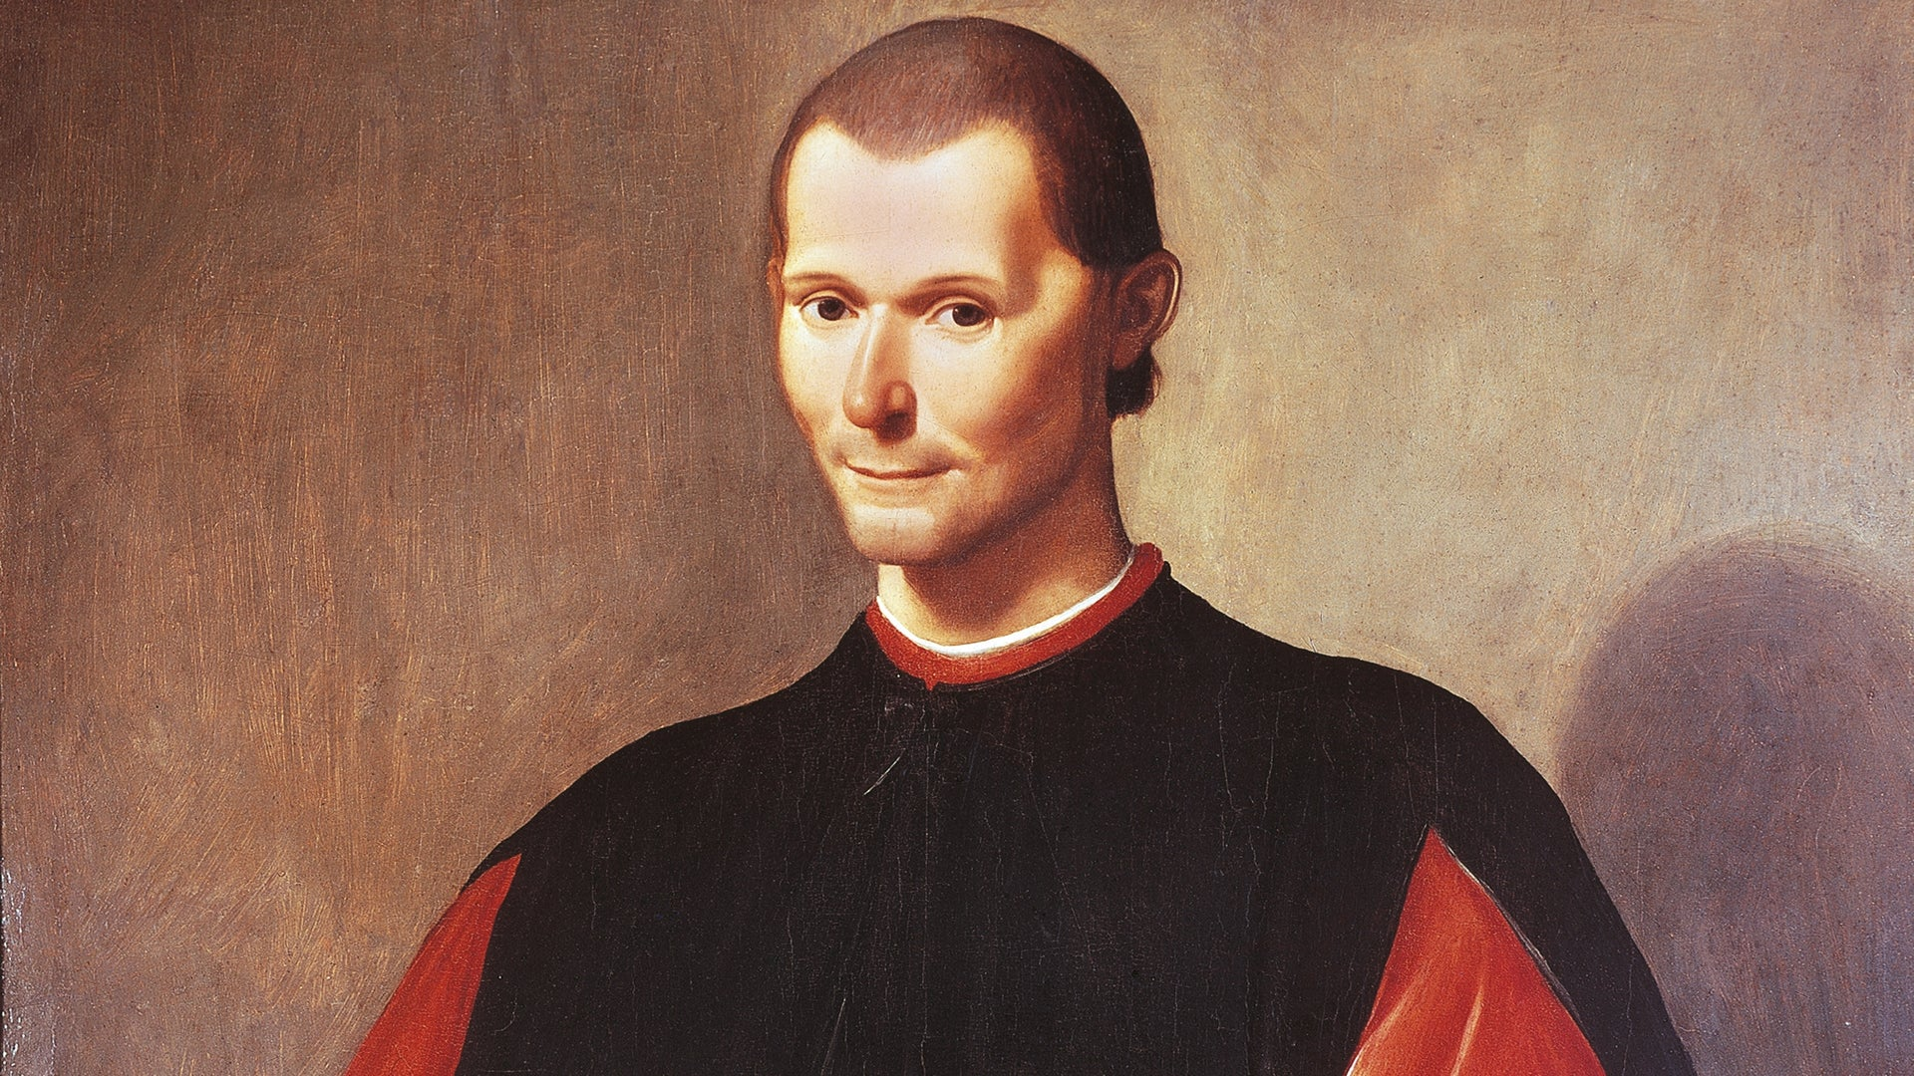
Machiavelli
“The Teacher of Evil”

Slide 2
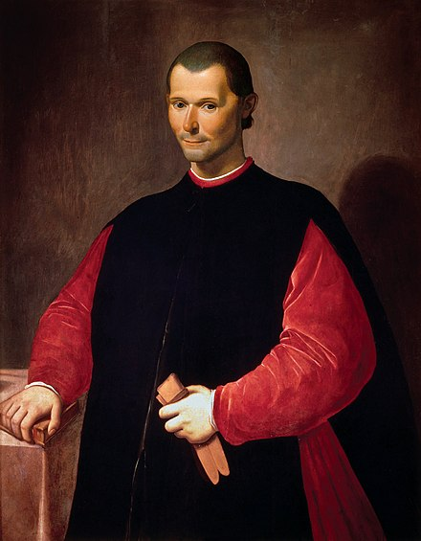
Niccolò di Bernardo dei Machiavelli
(1469-1527)
Renaissance author, philosopher, historian
Called the father of modern political philosophy
Worked in the Florentine Republic as senior official → responsibilities in military and diplomatic affairs
  Secretary Chancery of the Republic of Florence, 1498-1512
Wrote poetry, comedies, and carnival songs
Kept personal correspondences that are often used by historians
Best known for The Prince, 1513, 1532

Slide 3
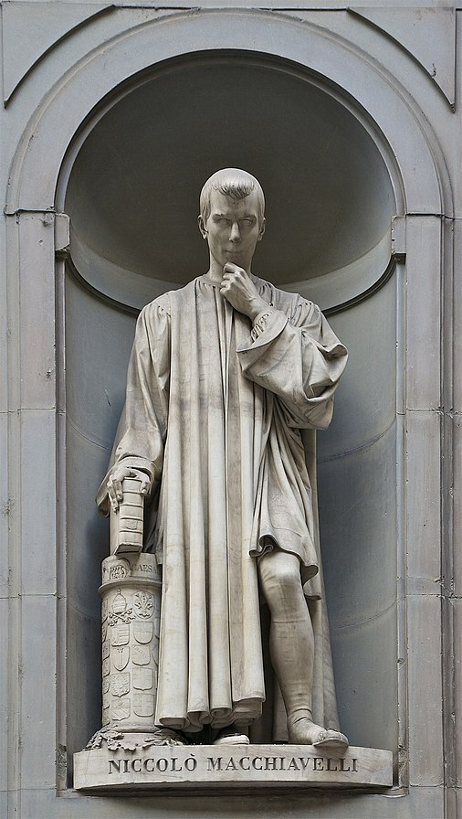
Legacy
After death, name evoked the unscrupulous actions he advised in The Prince
Claimed that his time studying history taught him that politics were always experimenting with crime and deception.
In the event of establishing a new governance, if the ruler is criticized for deeds (even violence), he should be excused if his intentions are good (i.e. beneficial to him)
Is The Prince a straightforward account of a political reality? Or is it a manual for tyrants to seize power?
Machiavellian: political deceit, realpolitik, deviousness
  Realpolitik: based on material factors or the situation rather than based on ideals or ethical principles

Slide 4
The Prince
Instead of focus on a hereditary prince (a more traditional target audience), work interested in a “new prince”
  Hereditary prince: to retain power must have a careful balance of the interests of different institutions that the people are accustomed to
  New prince: more difficult task → has to stabilize new power to build solid political structures
Can still have social stability and security under moral corruption → differentiates between public and private morality
Concerned for reputation, but must be able to act immorally at the right times
Better to be feared than loved
  Beloved ruler retains authority by obligation → feared ruler keeps order by fear of punishment
Argues for the necessity of the use of deceit or force → including wiping out entire noble families

Slide 5
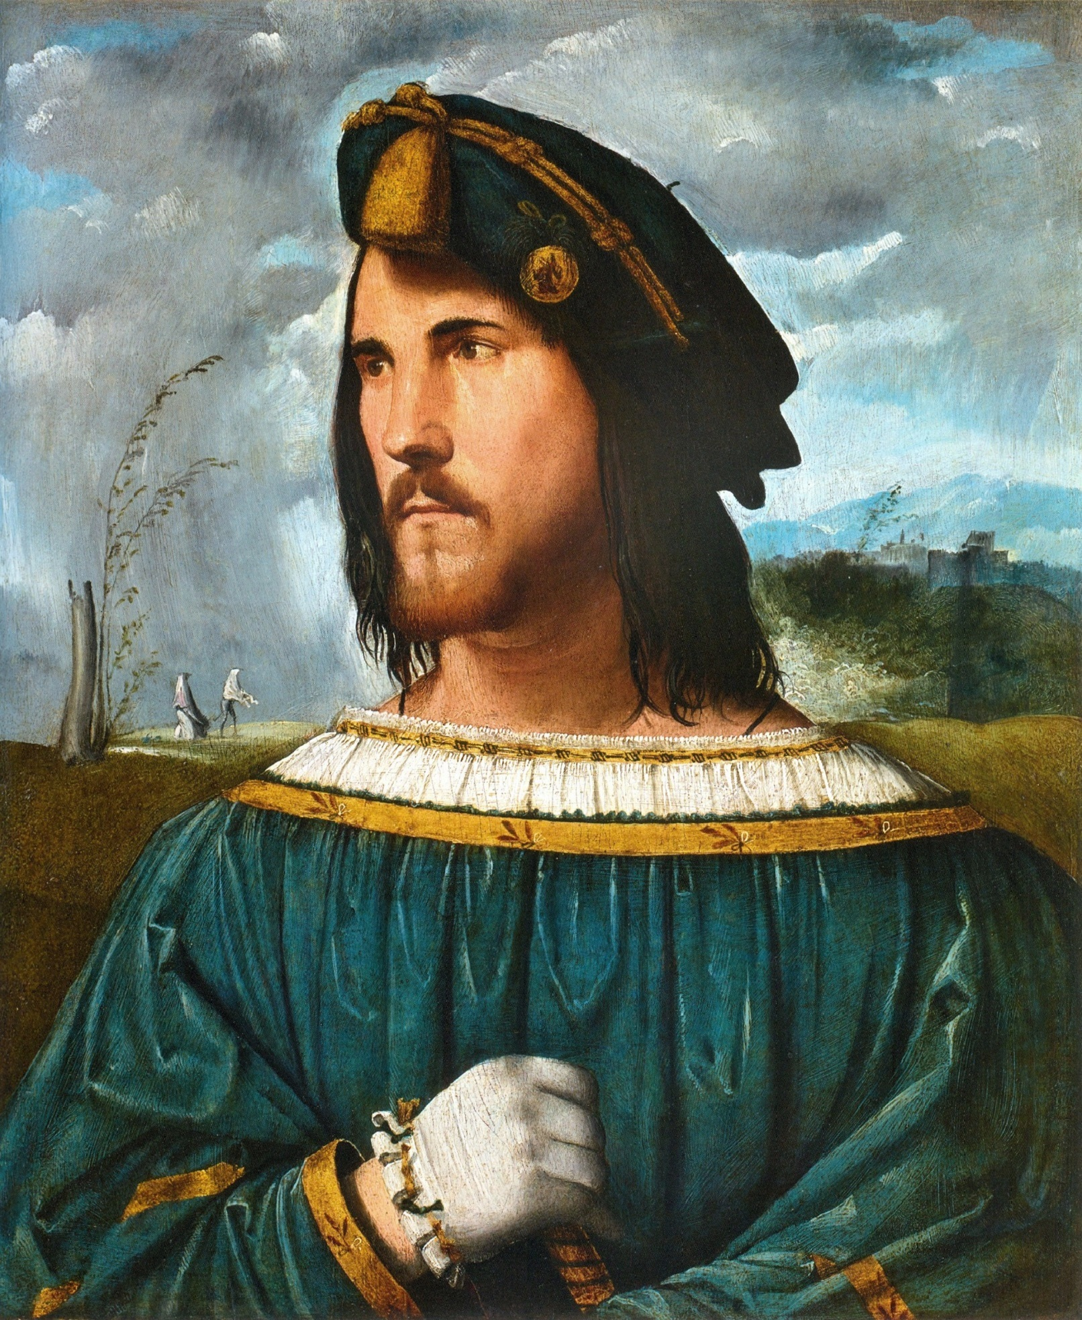
Political instrumentality
“The ends justify the means”
Fraud, deceit, and violence are necessary for a prince to use
Violence is permissible:
  To secure new rule
  To secure new political institutions
  Eliminate political rivals
  Destroy resistant populations
  Get rid of other men who might be able to rule, who might attempt to replace the ruler
Portrait of a Gentleman (Cesare Borgia), used as an example of a successful ruler in The Prince

Slide 6
Interpretations
Catholic Church bans The Prince, putting it on the Index Librorum Prohibitorum
His contemporary humanists, such as Erasmus, viewed the book negatively
Contribution in political thought: a break between political realism and political idealism
  Prince should shout look at imaginary ideal society, but should focus on what is existent (contrast with Plato)
The Prince: advice to tyrannical princes
Discourses on Livy: more republican
Rousseau calls The Prince satire
Antonio Gramsci: the audience for Machiavelli’s work was not the ruling class, but the common people → rulers already knew this information through their education

Slide 7
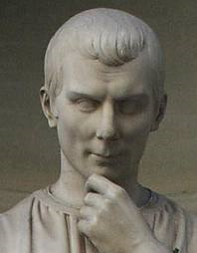
Influence of classical political philosophy
Aristotle was a major influence in philosophy during the late Middle Ages → including the Catholicised form in Thomas Aquinas
  And more controversial “Averroist” form in Marsilius of Padua
Machiavalli rarely cites Plato and Aristotle and seemed not to approve of them
Leo Strauss: strong influence of Xenophon on Machiavelli
  Student of Socrates more known as historian and rhetorician → sometimes not in line with Aristotle
Interest in Plato on the rise in Florence at the time, Machiavelli didn’t have much interest in him
More interested and influenced by readings of Plutarch and Cicero

Slide 8
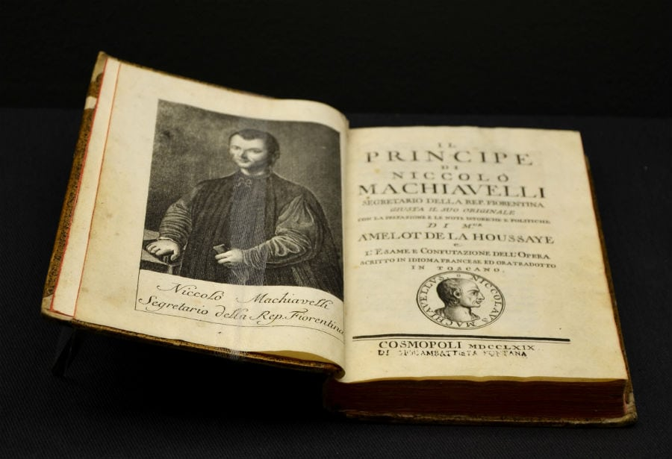
Divergence with Socrates
Major difference is Machiavelli’s materialism
Rejection of telos of nature
Believed that political study was higher than philosophy
Socrates on telos: everything acts towards some end, as if nature itself had designed that outcome
Machiavelli: things happen by random luck and chance or through will and human action

Slide 9
Politics: Empiricism or Theology?
Prototype for modern empirical social scientist → builds his ideas from experiences and historical facts rather than theology, abstract ideas, or imagination
Frees politics from moral philosophy and from theology → describes what rulers actually do and its effectiveness → questions of good or bad are ignored
Attempt merely to discover what actually happens
How does this align with the values of humanism?
He emancipated politics from theology and moral philosophy. He undertook to describe simply what rulers actually did and thus anticipated what was later called the scientific spirit in which questions of good and bad are ignored, and the observer attempts to discover only what really happens. — Joshua Kaplan, 2005

Slide 10
Felt that his early schooling along the lines of a traditional classical education was essentially useless for the purpose of understanding politics.
Advocated intensive study of the past → particularly regarding the founding of a city → key to understanding its later development
Studied the way people lived and aimed to inform leaders how they should rule and even how they themselves should live.
Living virtuously does not always lead to happiness → misery one of the vices that enables a prince to rule.
Machiavelli: "it would be best to be both loved and feared. But since the two rarely come together, anyone compelled to choose will find greater security in being feared than in being loved.“

