Slide 1
Humanism and Neoplatonism
GENT 407: The Early Renaissance (1350-1520)
Stephanie Spoto
Monterey Peninsula College

Slide 2
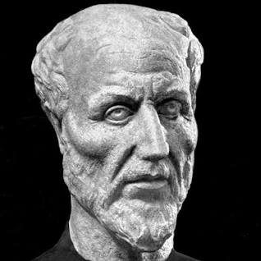
Neoplatonism in the Ancient World
Originally emerged in 3rd century CE → usually refers to a set of thinkers rather than single system of thought or set of ideas
Common idea is that all reality can be derived from single principle of “The One” (monism)
We studied Plotinus (204-271 CE), and it’s ancient influence stretched until the 6th century
Other important ancient Neoplatonic philosophers: Porphyry and Iamblicus

Slide 3
Renaissance Revival
Studies suggest that Neoplatonism survived in the Eastern Christian Church → brought back to the West by avowed pagan and opponent of the church, Pletho (1355-1454).
Encouraged a move away from Aristotle to Plato
Neoplatonic students are among the most famous philosophers in the Northern Italian Renaissance
Rather than being a mere continuation of Plato’s ideas, Neoplatonism was a independent philosophy which evolved in the early Renaissance
Fall of Byzantine Empire → scholars who were considered “the librarians of the world” left Constantinople with their books and many traveled to Italy

Slide 4
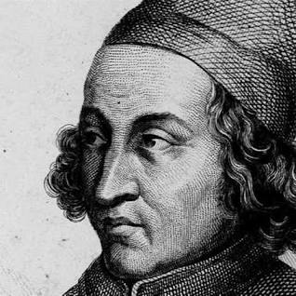
Marsilio Ficino (1433-1499)
Important Renaissance scholar and Catholic priest
1462: Cosimo I de’Medici provided Ficino with all 36 of Plato’s dialogues for him to translate → 1462-1469 Ficino worked on this translation from Greek to Latin which made Plato accessible to Italian scholars.
Then he moved on to translate the works of Plotinus → making them available in the Latin speaking world for the first time
On Platonic Love: Ficino coins this term in a letter to Alamanno Donati 1476
  Publishes a series of Platonic love letters to friend and scholar Giovanni Cavalcanti → letters explored idea of Platonic love.

Slide 5
Giovanni Pico della Mirandola
(1463-1494)
Student of Ficino → also based his ideas on Plato, still had deep respect for Aristotle
Although he was a product of the studia humanitatis, Pico was constitutionally an eclectic
  he represented a reaction against the exaggerations of pure humanism, defending what he believed to be the best of the medieval and Islamic commentators
It was always Pico's aim to reconcile the schools of Plato and Aristotle
  believed they used different words to express the same concepts.
Pico believed that an educated person should also study Hebrew and Talmudic sources, and the Hermetics
  he thought they represented the same concept of God that is seen in the Old Testament, but in different words.

Slide 6
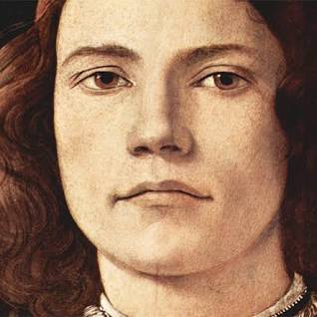
Oration on the Dignity of Man 1486
Called “The Manifesto of the Renaissance”
“We have given to thee, Adam, no fixed seat, no form of thy own, no gift peculiarly thine, that thou mayest feel as thine own, have as thine own, possess as thine own, the seat, the form, the gifts which thou thyself shalt desire. A limited nature in other creatures is confined within the laws written down by Us.”

Slide 7
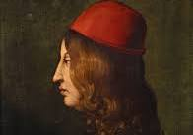
The potential of the Human
Oration: remaps the human landscape to center all attention on human capacity and human perspective
Arriving in a place near Florence, he taught the amazing capacity of human achievement
Wanted the Oration to be the introduction to a massive compendium of all the intellectual achievements of humanity → not able to start project because of early death

Slide 8
Dignity of the Studia Humanitatis
Pico della Mirandola intended to speak in front of an invited audience of scholars and clerics of the dignity of the liberal arts and about the glory of angels.
Of these angels he spoke of three divisions in particular: the Seraphim, Cherubim, and Thrones → the highest three choirs in the angel hierarchy, each one embodying a different virtue.
  The Seraphim: charity → one must "burn with love for the Creator". (Highest)
  The Cherubim: intelligence → contemplation and meditation.
  Thrones: justice → being just in ruling over "inferior things".
Hierarchy of angels makes sense to Pico: the philosopher "is a creature of Heaven and not of earth" because they are capable of obtaining any one of the statuses
Philosopher able to do this through studia humanitatis

Slide 9
The quest for knowledge
Justified the importance of the human quest for knowledge within a Neoplatonic framework.
After God had created all creatures, He conceived of the desire for another sentient being who would appreciate all His works,
  Oh no! There was no longer any room in the chain of being; all the possible slots from angels to worms had been filled.
  So, God created man such that he had no specific slot in the chain → men were capable of learning from and imitating any existing creature.
  When man philosophizes, he ascends the chain of being towards the angels, and communion with God.
  When he fails to exercise his intellect, he vegetates.
Philosophers are best ☺

Slide 10
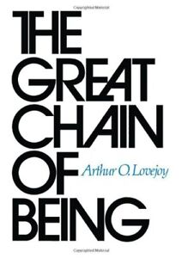
The Great Chain of Being
Men could ascend the chain of being through the exercise of their intellectual capacities → profound endorsement of the dignity of human existence in this earthly life
The root of this dignity lay in his assertion that only human beings could change themselves through their own free will → all other changes in nature were the result of some outside force acting on whatever it is that undergoes change.
Change is the only constant: he observed from history that philosophies and institutions were always in change → man's capacity for self-transformation the only constant.
Belief that all of creation constitutes a symbolic reflection of the divinity of God
Pico's philosophies had a profound influence on the arts → elevates writers and painters from their medieval role as mere artisans to the Renaissance ideal of the artist as genius.

Slide 11
Death and Exhumation in 2007
1494, age 31, Pico died under mysterious circumstances along with his friend Poliziano.
It was rumoured that his own secretary had poisoned him because Pico had become too close to Savonarola.
He was interred together with Girolamo Benivieni at San Marco, and Savonarola delivered the funeral oration. Ficino wrote:
Our dear Pico left us on the same day that Charles VIII was entering Florence, and the tears of men of letters compensated for the joy of the people. Without the light brought by the king of France, Florence might perhaps have never seen a more somber day than that which extinguished Mirandola's light.
2007, the bodies of Poliziano and Pico were exhumed from the Church of San Marco in Florence → What caused their death?
  Forensic tests showed that both Poliziano and Pico likely died of arsenic poisoning

