Slide 1
Greek Tragedy I: Sophocles’ Oedipus the King
Alan J. M. Haffa
Please Silence Cell Phones

Slide 2
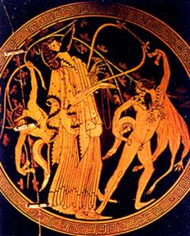
Key Terms
Chorus: to dance
Orchestra: Place where Chorus dances
Theatron: Place from which Spectators Watch
Drama: to do; emphasis upon Action
Skene: covered place, tent; generally, a house, temple, dwelling place; a wooden stage for actors
Katharsis: Purgation of Fear or

Slide 3
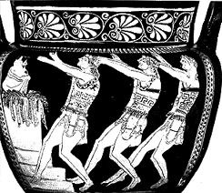
Chorus

Slide 4
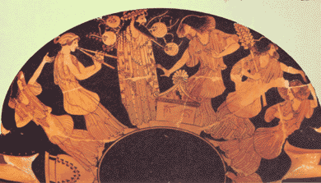
Dionysian Revel and Dancing

Slide 5


MASKS

Slide 6
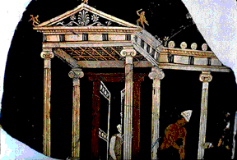
Skenographia: Sophocles

Slide 7
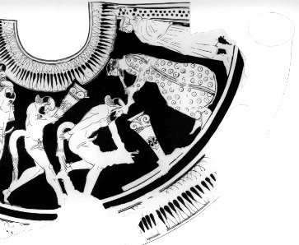
Satyr Play: Euripides Cyclops

Slide 8
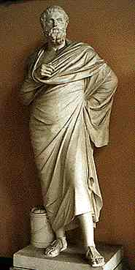
Sophocles (496-406
Defeated Aeschylus in first attempt in 462
125 plays (8 survive); 18 first prizes; acted himself
Priest of Asclepius; Board of Generals; Director of Treasury
Introduced Third Actor
Best known for Oedipus Cycle: Oedipus Rex, Antigone; Oedipus at Colonus
Characters maintain classical balance and restrain but are more human than in Aeschylus

Slide 9
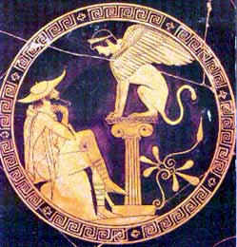
Oedipus the King
Thebans appeal as suppliants to Oedipus; Plague parallels historic plague of Athens
Oedipus likened to the gods: Priest, “You are not one of the immortal gods, we know; yet we have come to make our prayer as to the man surest in mortal ways and wisest in the ways of God. You saved us from the Sphinx…O mighty power, we turn to you: Find us our safety, find us a remedy, whether by counsel of the gods or of men.”

Slide 10
Dramatic Irony
We know something the character does not: the blindness of Oedipus to his own fate and situation
He is in fact the cause of the plague
Yet he responds to the suppliant citizens: “I know that you are deathly sick; and yet, sick as you are, not one is as sick as I. Each of you suffers in himself alone, his anguish, not another’s; but my spirit groans for the city, for myself, for you.”
Oedipus is a noble figure, one who feels pain at the pain of his subjects
When he discovers that he is the cause of their pain the irony of his situation is compelling and pathetic

Slide 11
Oracle of Delphi: Find the Murderer of Laios
Kreon reports: “The god commands us to expel from the land of Thebes an old defilement we are sheltering: it is a deathly thing, beyond cure; we must not let it feed upon us longer.”
The defilement is murder of the former King, Laios.
Dramatic Irony: Oedipus curses whoever is the murder; “I pray that man’s life be consumed in evil and wretchedness. And as for me, this curse applies no less if it should turn out that the culprit is my guest here, sharing my hearth.”

Slide 12
Prophet and King
Teiresias the prophet is summoned
He refuses to tell who is the killer and Oedipus gets angry and accuses him.
Oedipus charges that Kreon and T. have plotted against him and he goes so far as to speak blasphemies against religion.
“Kreon desires in secret to destroy me! He has bought this decrepit fortune-teller, this collector of dirty pennies, this prophet fraud—Why, he is no more clairvoyant than I am!”
His “mummeries” were no help against the Sphinx, “Your birds—what good were they? Or the gods, for that matter? But I came by, Oedipus...”
The hubris of Oedipus is highlighted here

Slide 13
Sight, blindness and Truth
To see is to know in Greek
The blind prophet tells Oedipus: “you have your eyes but see not where you are in sin, nor where you live, nor whom you live with. Do you know who your parents are?”
Later, Oedipus will blind himself—and only after will he learn to see the truth.

Slide 14
Iocaste Questions Priests and Prophets
Recounts a prophecy of Apollo said that Laios would be killed by his own son
Yet, he is said to have been killed by highwaymen and his son had his ankles pierced and was left to die on a mountainside
“Thus, Apollo never caused that child to kill his father, and it was not Laios’ fate to die at the hands of his son, as he feared. This is what prophets and prophecies are worth! Have no dread of them.”

Slide 15
Avoiding Fate, Oedipus has fulfilled Fate and the God’s Prophecy
He recounts how in Corinth he received a similar prophecy: he was told he would kill his father and marry his mother
He left Corinth to avoid this fate
Coming toward Thebes he struck a man along the road

Slide 16
Chorus comments on Oedipus’ Hubris
“The tyrant is a sick child of Pride who drinks from the sickening cup Recklessness and vanity, until from his high crest headlong he plummets…”
“Haughtiness and high hand of disdain tempt and outrage God’s holy law; And any mortal who dares hold no immortal Power in awe will be caught up in a net of pain.”

Slide 17
Chorus comments on Oedipus as example of Man subject to Fate
O generations of men, how I count you aw equal with those who live not at all!
What man, what man on earth wins more of happiness than a seeming
And after that turning away?
Oeipus, you are my pattern of this,
Odipus, you and your fate!
Luckless Oedipus, whom of all men
I envy not at all”

Slide 18
Pity for Daughters
After he learns the truth, a messenger tells us that Oedipus broke open the palace doors to find Iocaste hung. He took the brooch from her body and stabbed his eyes.
He stands before the Chorus and exiles himself from Thebes
His daughters are most pitiable, being blameless. “I weep for you when I think of the bitterness men will visit upon you all your lives. What homes, what festivals can you attend…and when you come to marriage age, where is the man, my daughters, who would dare risk the bane that lies on all my children.”

Slide 19
Chorus Pities Oedipus
Chorus: “Men of Thebes, look upon Oedipus. This is the king who solved the famous riddle and towered up, most powerful of men. No mortal eyes but looked on him with envy, yet in the end ruin swept over him. Let every man in mankind’s frailty consider his last day; and let none presume on his good fortune until he find Life, at his death, a memory without pain.”
Lament on the uncertainty of life
Greek view of Happiness: pessimistic

Slide 20
Conclusions
Aeschylus endorses traditional Gods and Religion as Symbols of Order
Sophocles Questions Gods (Oedipus and Prophet Teiresias)
Power of Fate cannot be resisted
Vicissitudes of Human Fortune
Hubris, even of a great man, will bring down the god’s retribution

