Slide 1
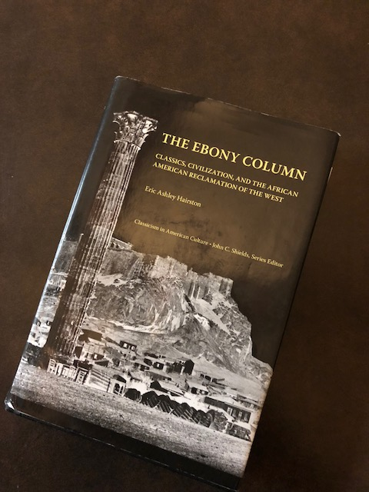
The Ebony Column: Classics, Civilization, and the African American Reclamation of the West
By Eric Ashley Hairston
The University of Tennessee Press Knoxville 2013

Slide 2
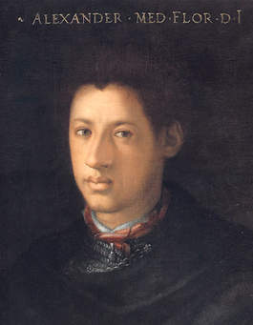
Born to a dark skinned maid and Lorenzo II de Medici, the illegitimate Alessandro was groomed for power. In 1532 at the age of nineteen, backed by the Holy Roman Emperor his future father-in-law and the pope, he became Duke of Florence. He ruled Florence for six years.

Slide 3
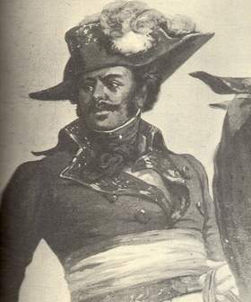
In 2012 Tom Reiss wrote The Black Count: Glory, Revolution, Betrayal, and the Real Count of Monte Cristo. The real Count of Monte Cristo happened to be the father of Alexandre Dumas author of classics The Count of Monte Cristo and The Three Musketeers. The son Alex Dumas used his fathers larger than life exploits as inspiration for his classics.

Slide 4
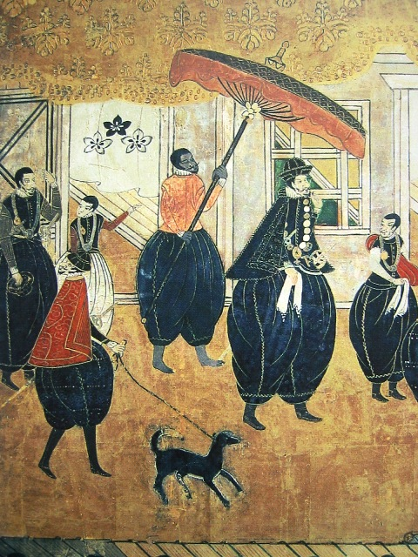
Yasuke was a Samurai of black African origin. Yasuke arrived in Japan in 1579 in the service if an Italian Jesuit. He was an exotic in Japan. In one event, several people were crushed to death while clamoring to get a look at him. Yasuke eventually entered the service of Samurai Oda Noburaga.

