Slide 1
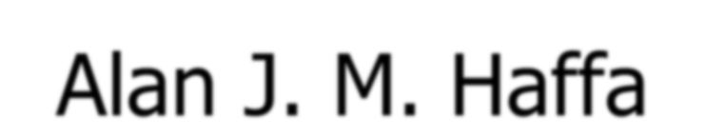

Greek Tragedy: Aeschylus’ Oresteia
Alan J. M. Haffa

Slide 2
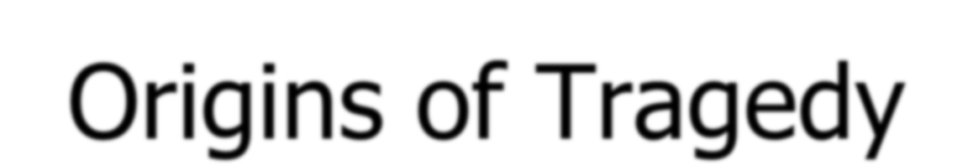



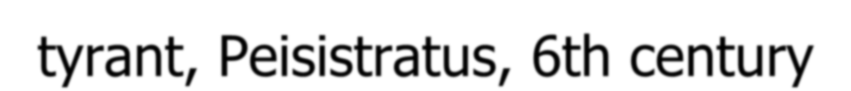

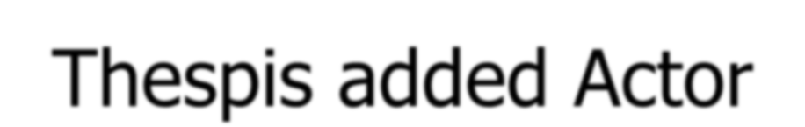
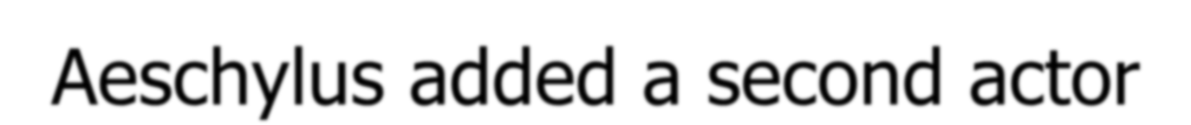
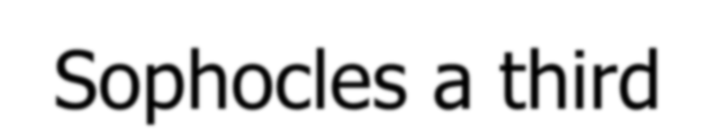
Origins of Tragedy
►Aristotle in Poetics
►Greater Dionysia festival in Athens under tyrant, Peisistratus, 6th century
►Chorus
►Thespis added Actor
►Aeschylus added a second actor
►Sophocles a third
►Much that we do not know; but linked to Dionysus and Religion; Satyr plays a remembrance of this focus on Dionysus

Slide 3
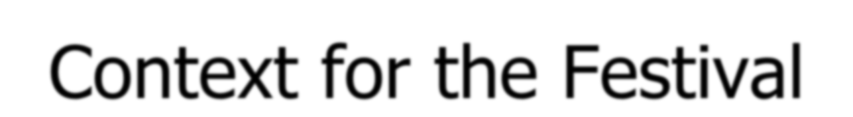




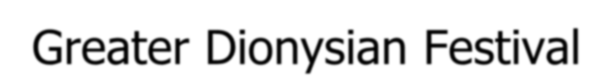
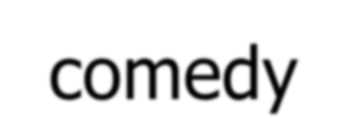
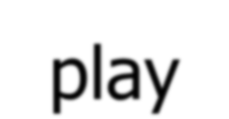
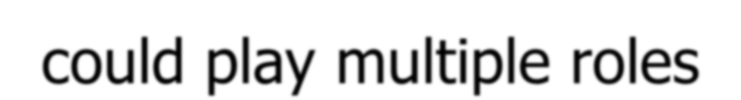
Context for the Festival
► First in Athens
► Greater Dionysian Festival
► Archon would choose three tragedians
► Each would produce three tragedies and one
comedy
► Archon appointed choregoi, to finance the chorus
► Actors were assigned plays by lot; three actors per
play
► All actors were male citizens, wore masks, and could play multiple roles

Slide 4

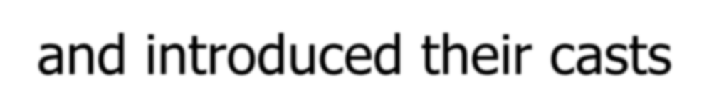
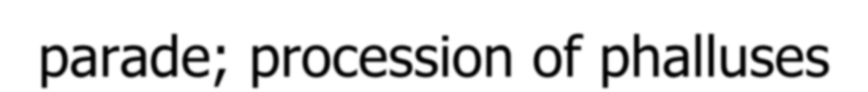
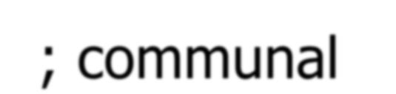
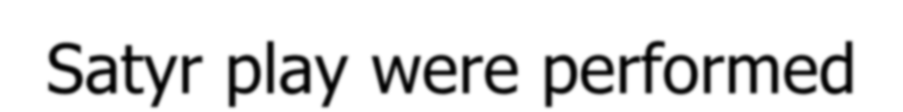

Timeline
► In March, the Statue was brought to the Temple
► Proagon: two days before the plays were performed, playwrights announced their subjects and introduced their casts
► Pompe: The first day of the festival was a huge parade; procession of phalluses; communal sacrifices of Bulls and libations of wine
► Competitions of men’s and boys choruses on a tribal
basis and even prisoners were released on bail
► Each of the next three days, three tragedies and a
Satyr play were performed
► The fifth day Five Comedies were staged

Slide 5



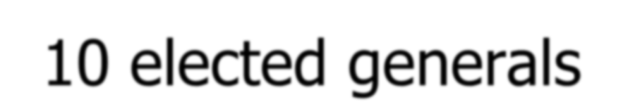
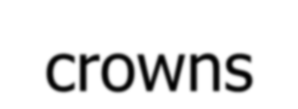
Political and Social
Interconectedness
►The Sacrifice and Libations were led by the
10 elected generals
►The names of those citizens who had dome something noteworthy for the polis were announced and they were awarded laurel crowns
►Parade of orphans and giving them arms
►Tribute of Allies was presented (after 454)

Slide 6
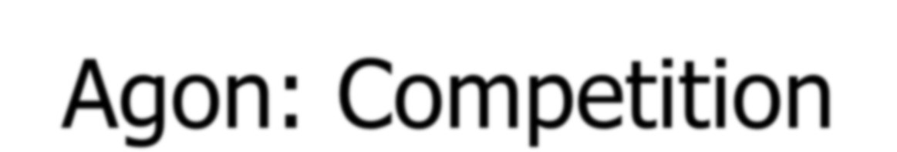
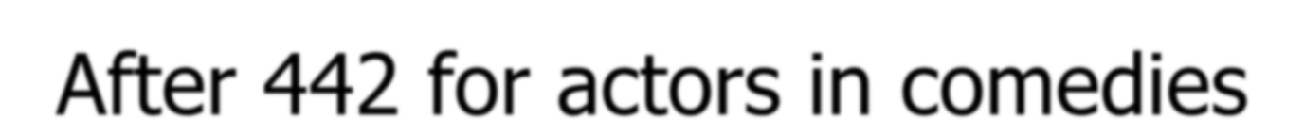
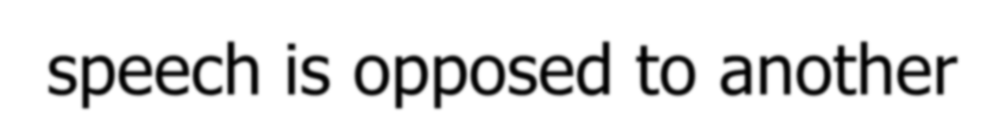
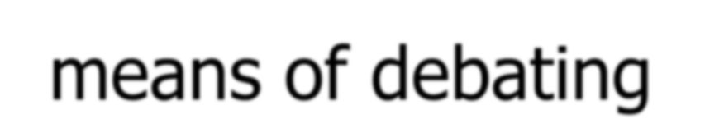
Agon: Competition
►10 Judges, one chosen from each tribe by
lot, to try and reduce bribery and cheating
►After 449, competition for actors too
►After 442 for actors in comedies
►Agon in the plays: the set pieces where one
speech is opposed to another
►Theatre was a place where conflicting social values were set forth and opposed as a means of debating

Slide 7
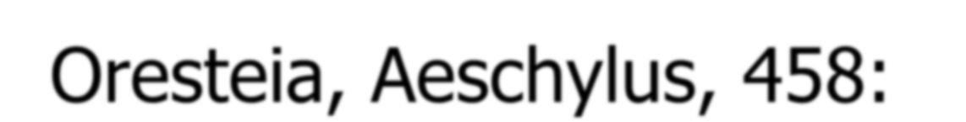
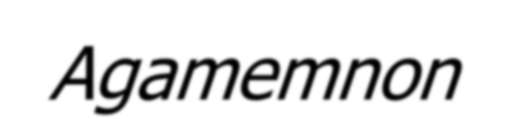


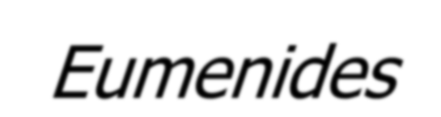
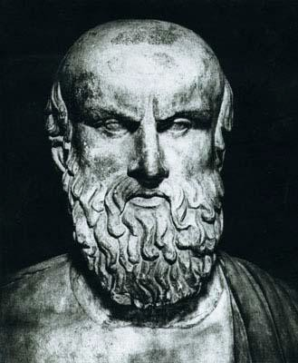
Oresteia, Aeschylus, 458: Agamemnon,
Libation Bearers, Eumenides

Slide 8
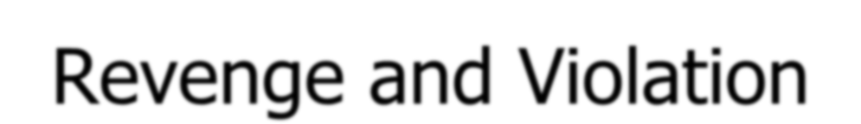
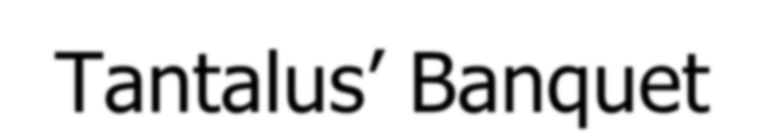

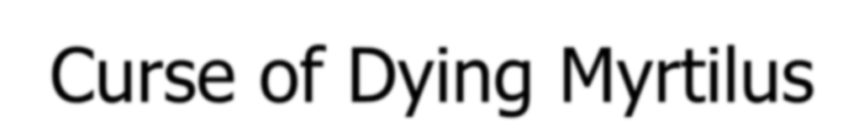
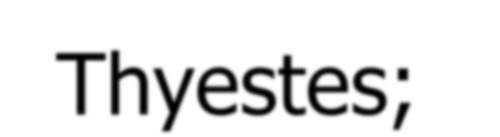
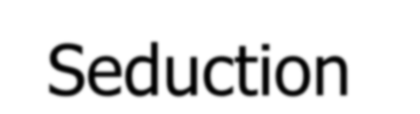
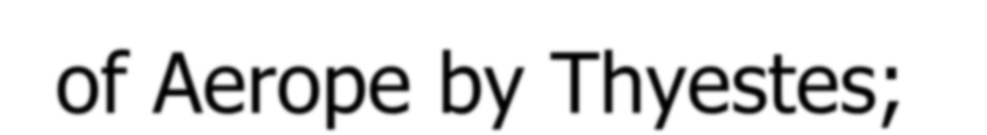


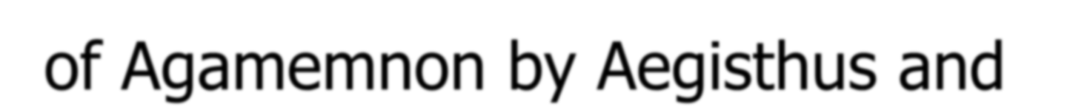
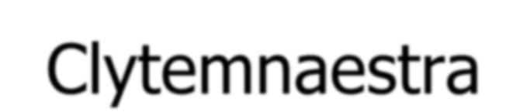

Curse of the House of Atreus: Repetition of
Revenge and Violation
►Tantalus’ Banquet
►Pelops (Pelop + Nesus + Peloponnesus): Race for Hippodamia against her father, Oenomaus; Curse of Dying Myrtilus
►Ascension to throne of Mycenae: Atreus and Thyestes; Seduction of Aerope by Thyestes; “Reconciliation” banquet; Thyestes curses Atreus
►Murder of Agamemnon by Aegisthus and Clytemnaestra
►Orestes Killed Clytemnaestra

Slide 9
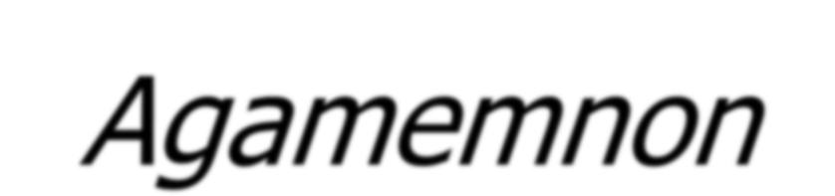


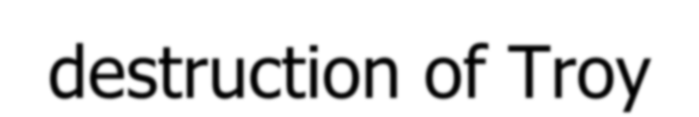
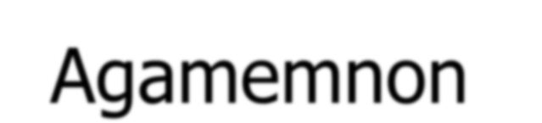
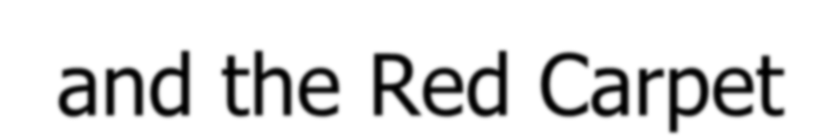
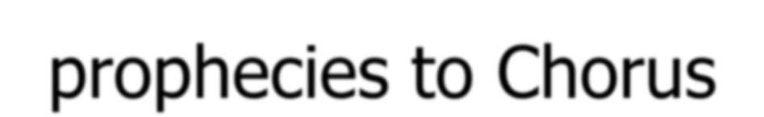
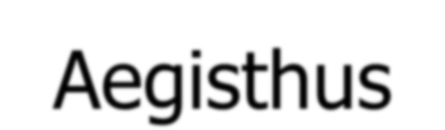
Agamemnon Plot
►A Watcher sees the Fires announcing the
destruction of Troy
►Agamemnon and the Red Carpet
►Murder happens off stage as Cassandra prophecies to Chorus
►Clytemnestra comes out with the body
►The Chorus is threatened and repressed by Aegisthus

Slide 10
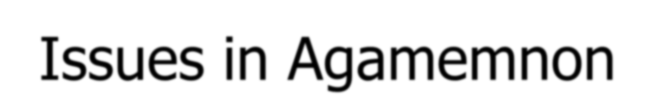
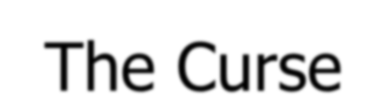
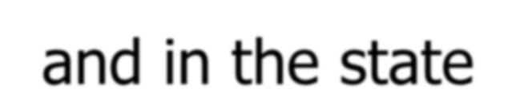
Issues in Agamemnon
► Justice: Clytemnaestra is angry because of the death
of Iphigeneia and also because of Cassandra
► The Curse
► Female Power: Clytemnestra is called masculine by
the Chorus; she is seen as a threat
► Politics: with the death of Agamemnon and the rise of Aegisthus, there is threat of civil war;
► The whole play dramatizes the conflict that arises when there is no order or hierarchy in the family and in the state

Slide 11


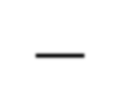
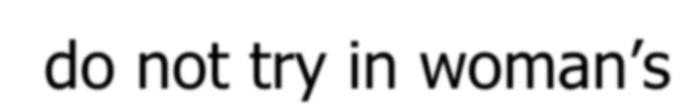
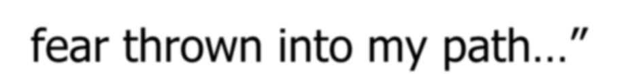
Red Carpet
► C: “Now my beloved one, step from your chariot; yet let not
your foot, my lord, sacker of Ilium, touch the earth…
► A: Daughter of Leda, you who kept my house for me, there is one way your welcome matched my absence well. You strained it to great length…And all this—do not try in woman’s ways to make me delicate, nor, as if I were some Asiatic bow down to earth and with wide mouth cry out to me, nor cross my path with jealousy by strewing the ground with robes. Such state becomes the gods, and non beside. I am a mortal, a man; I cannot trample upon these tinted splendors without fear thrown into my path…”

Slide 12
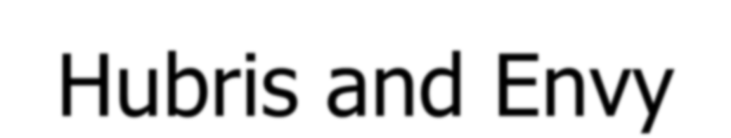

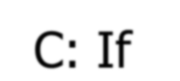
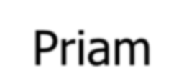
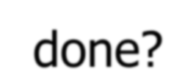
Hubris and Envy
► C: Yet tell me this one thing, and do not cross my will.
► A: My will is mine. I shall not make it soft for you.
► C: It was in fear surely that you vowed this course to God.
► A: No man has spoken knowing better what he said.
► C: If Priam had won as you have, what would he have done?
► A: I well believe he might have walked on tapestries.
► C: Be not ashamed before the bitterness of men.
► A: The people murmur, and their voice is great in strength.
► C:Yet he who goes unenvied shall not be admired.
► A: Surely this lust for conflict is not womanlike?

Slide 13
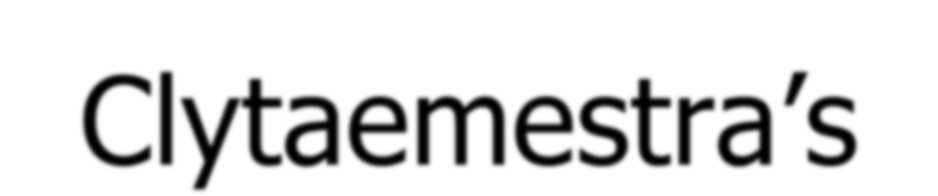




Clytaemestra’s boast
► “Thus to me the conflict born of ancient bitterness is not a thing new thought upon, but pondered deep in time. I stand now where I struck him down. The thing is done. Thus have I wrought, and I will not deny it now. That he might not escape nor beat aside his death, as fisherman cast their huge circling nets, I spread deadly abundance of rich robes, and caught him fast. I struck him …Thus he went down, and the life struggled out of him; and as he died he spattered me with the dark red and violent driven rain of bitter savored blood to make me glad, as gardens stand among the showers of God in glory at the birth-time of the buds…Were
it religion to pour wine above the slain, this man deserved, more than deserved, such sacrament.”

Slide 14



Chorus accuses her of Hubris and
Hamartia (crime)
►C: Great your design, your speech is a clamor of pride. Swung to the red act drives the fury within the brain signed clear in the splash of blood over your eyes. Yet to come is stroke, given for stroke, vengeance, forlorn of friends.”

Slide 15


Justice for Iphigenia and Jealousy
of Cassandra
►“Now hear you this, the right behind my sacrament: By my child’s Justice driven to fulfillment, by her Wrath and Fury, to whom I sacrificed this man…and her lies she, the captive of his spear, who saw wonders, who shared his bed, the wise in revelations and loving mistress..

Slide 16



Chorus blames Helen
►“Alas, Helen, wild heart, for the multitudes, for the thousand lives you killed under Troy’s shadow, you alone, to shine in man’s memory as blood flower never to be washed out.
►C: No, be not so heavy, nor yet draw down in prayer death’s ending, neither turn all wrath against Helen for men dead, that she alone killed all those Greek lives…

Slide 17












Aegisthus Boasts of Curse
Revenged
► O splendor and exaltation of this day of doom!
Now I can say once more that the high gods look down on mortal crimes to vindicate the right at last, now that I see this man—sweet sight—before me here sprawled in the tangling nets of fury, to atone the calculated evil of his father’s hand.
► Relates how Atreus drove Thyestes out. Then invited him to a feast and served Thyestes a meal of his own children

Slide 18







Chorus Judges Aegisthus
► They blame him for the murder but he puts the blame on
Clytaemestra for committing the act
► C: How shall you be lord of the men of Argos, you who planned the murder of this man, yet could not dare to act it out, and cut him down with your own hand?”
► A: No, clearly the deception was the woman’s part, and I was suspect, that had hated him so long. Still with his money I shall endeavor to control the citizens. The mutinous man shall feel the yoke drag at his neck, no cornfed racing colt that runs free traced; but hunger, grim companion of the dark dungeon shall see him broken to the hand at last.”

Slide 19








The Libation Bearers
►The return of Orestes and his friend Pylades
from exile
►A lock of hair dedicated at Agamemnon’s tomb is found by sister Electra
►Recognition Scene: oath of vengeance
►Orestes and Pylades enter palace in disguise
►Orestes kills Aegisthus and with the urging of Pylades, Clytemnestra
►Threatened by the Furies, he flees to seek help from Apollo

Slide 20





The Eumenides
► Clytemnestra’s ghost urges the Furies to avenge her
► Orestes flees to Delphi for sanctuary and purification
► The oracle tells him to go to Athens for justice from Athena
► A trial: Athena as judge, Apollo as defense, and
Furies as prosecutors
► Athena rules in favor of Orestes but tries to placate the Furies by giving them a special ritual and place in Athens; they become Good Spirits, Eumenides

Slide 21







Principal Issues in the Eumenides
► Apollo and Furies; Olympian Gods and Cthonic
Gods;
► Problem of Ritual Defilement and Purification
► Problem of Justice: Mutually Exclusive Claims of Justice; How to Balance the murder of a husband against the murder of a mother?; Problem of Vengeance and Cycle of Violence
► Gender Conflict

Slide 22




Resolution of Issues
►Olympian Gods are Supreme but a place is
made for the old; Furies Become Eumenides
►Male supremacy is asserted (Athena’s birth from the head of Zeus)
►Purification by Animal Sacrifice
►Institution of Areopagus (Court for Murder
and Treason)
►Old Dike and New Dike are harmonized?

Slide 23





Conclusion
►Aeschylus emphasizes the Power of the Gods
over the affairs of men
►But unlike earlier stories and myths, his gods seeks a new order and justice that is not arbitrary or capricious
►Religion and the power of the state are presented in a way that shows them in harmony
►His trilogies move from conflict toward
resolution and represent

